Slide 1
Swimming Portfolio
Emily Barton, Haleigh Miller, Stan Zhao

Slide 2
Proposal
Hours
Start in the mornings in time for post-practice meal
Stay for regular office hours (until 5pm)
Attend weekend meals and meets- including away meets if travel is paid for
Services provided
Counseling to student athlete regarding their question on nutrition and diet
Monitoring athlete’s progress and stats, in touch with head coach on the feedback of their performance
Give team talks regarding nutrition plan and educate athlete on the topic of nutrition
Provide food choices and educate athletes on how to prepare their meals
Location of office
Location where the athletes usually go, athletic buildings or gym and near locker room or some lower floors where athletes will have easy access to

Slide 3
Proposal (continued)
Responsibilities
Assess and counsel student-athletes on medical-related nutrition concerns utilizing appropriate Medical Nutrition Therapy techniques conditions such as but not limited to anemia, disordered eating, diabetes, bone mineral disturbances, amenorrhea, dyslipidemia, hypertension, gastrointestinal concerns, food allergies and intolerances, and other medical conditions.
Provide team-specific nutrition trainings and recommendations.
Provide consistent communication to coaching staffs, strength & conditioning staffs, athletic trainers, team physicians, mental health staffs, and administration regarding sports nutrition and sports performance related issues.
Oversight of fueling stations and staff management.
Actively participate in meal monitoring and plate-side nutrition education for student athletes at training table meals.
Maintain knowledge of and compliance with specific NCAA, SEC, and institution rules
Budgetary Responsibilities

Slide 4
Proposal (continued)
Visibility
In office during regular office hours
Must in office before, during and after athletes’ training
Reporting Lines
Report directly to head coach
Contact with assistant coaches and strength coaches to inform them of nutrition plan
Contact fueling station staff with the information on nutrition plan
Travel
Willing to travel with team to competitions
Willing to travel outside for nutrition fair or conference
Body Composition Services
Understand and able to operate major measurement tools for body composition
Skin calipers, Bioelectrical Impedance, Hydrostatic Weighing, DEXA, Bod Pod

Slide 5
Proposal (continued)
Frequency of meetings: Coaches/staff, athletes, etc
Meeting with coach weekly regarding the performance of each athlete
Meeting with the whole team once during academic year to give team talk
Meeting with individual athlete if he/she had requested or noticed by head coach regarding their performance due to nutrition and diet
Meeting with fueling station staff regarding the nutrition plan
Meeting with athlete’s family if their assistance for athlete’s nutrition intervention are necessary
Competition
Monitor athlete’s diet during competition
Give immediate nutrition intervention if the performance declined
Prepare foods for athletes during competition

Slide 7
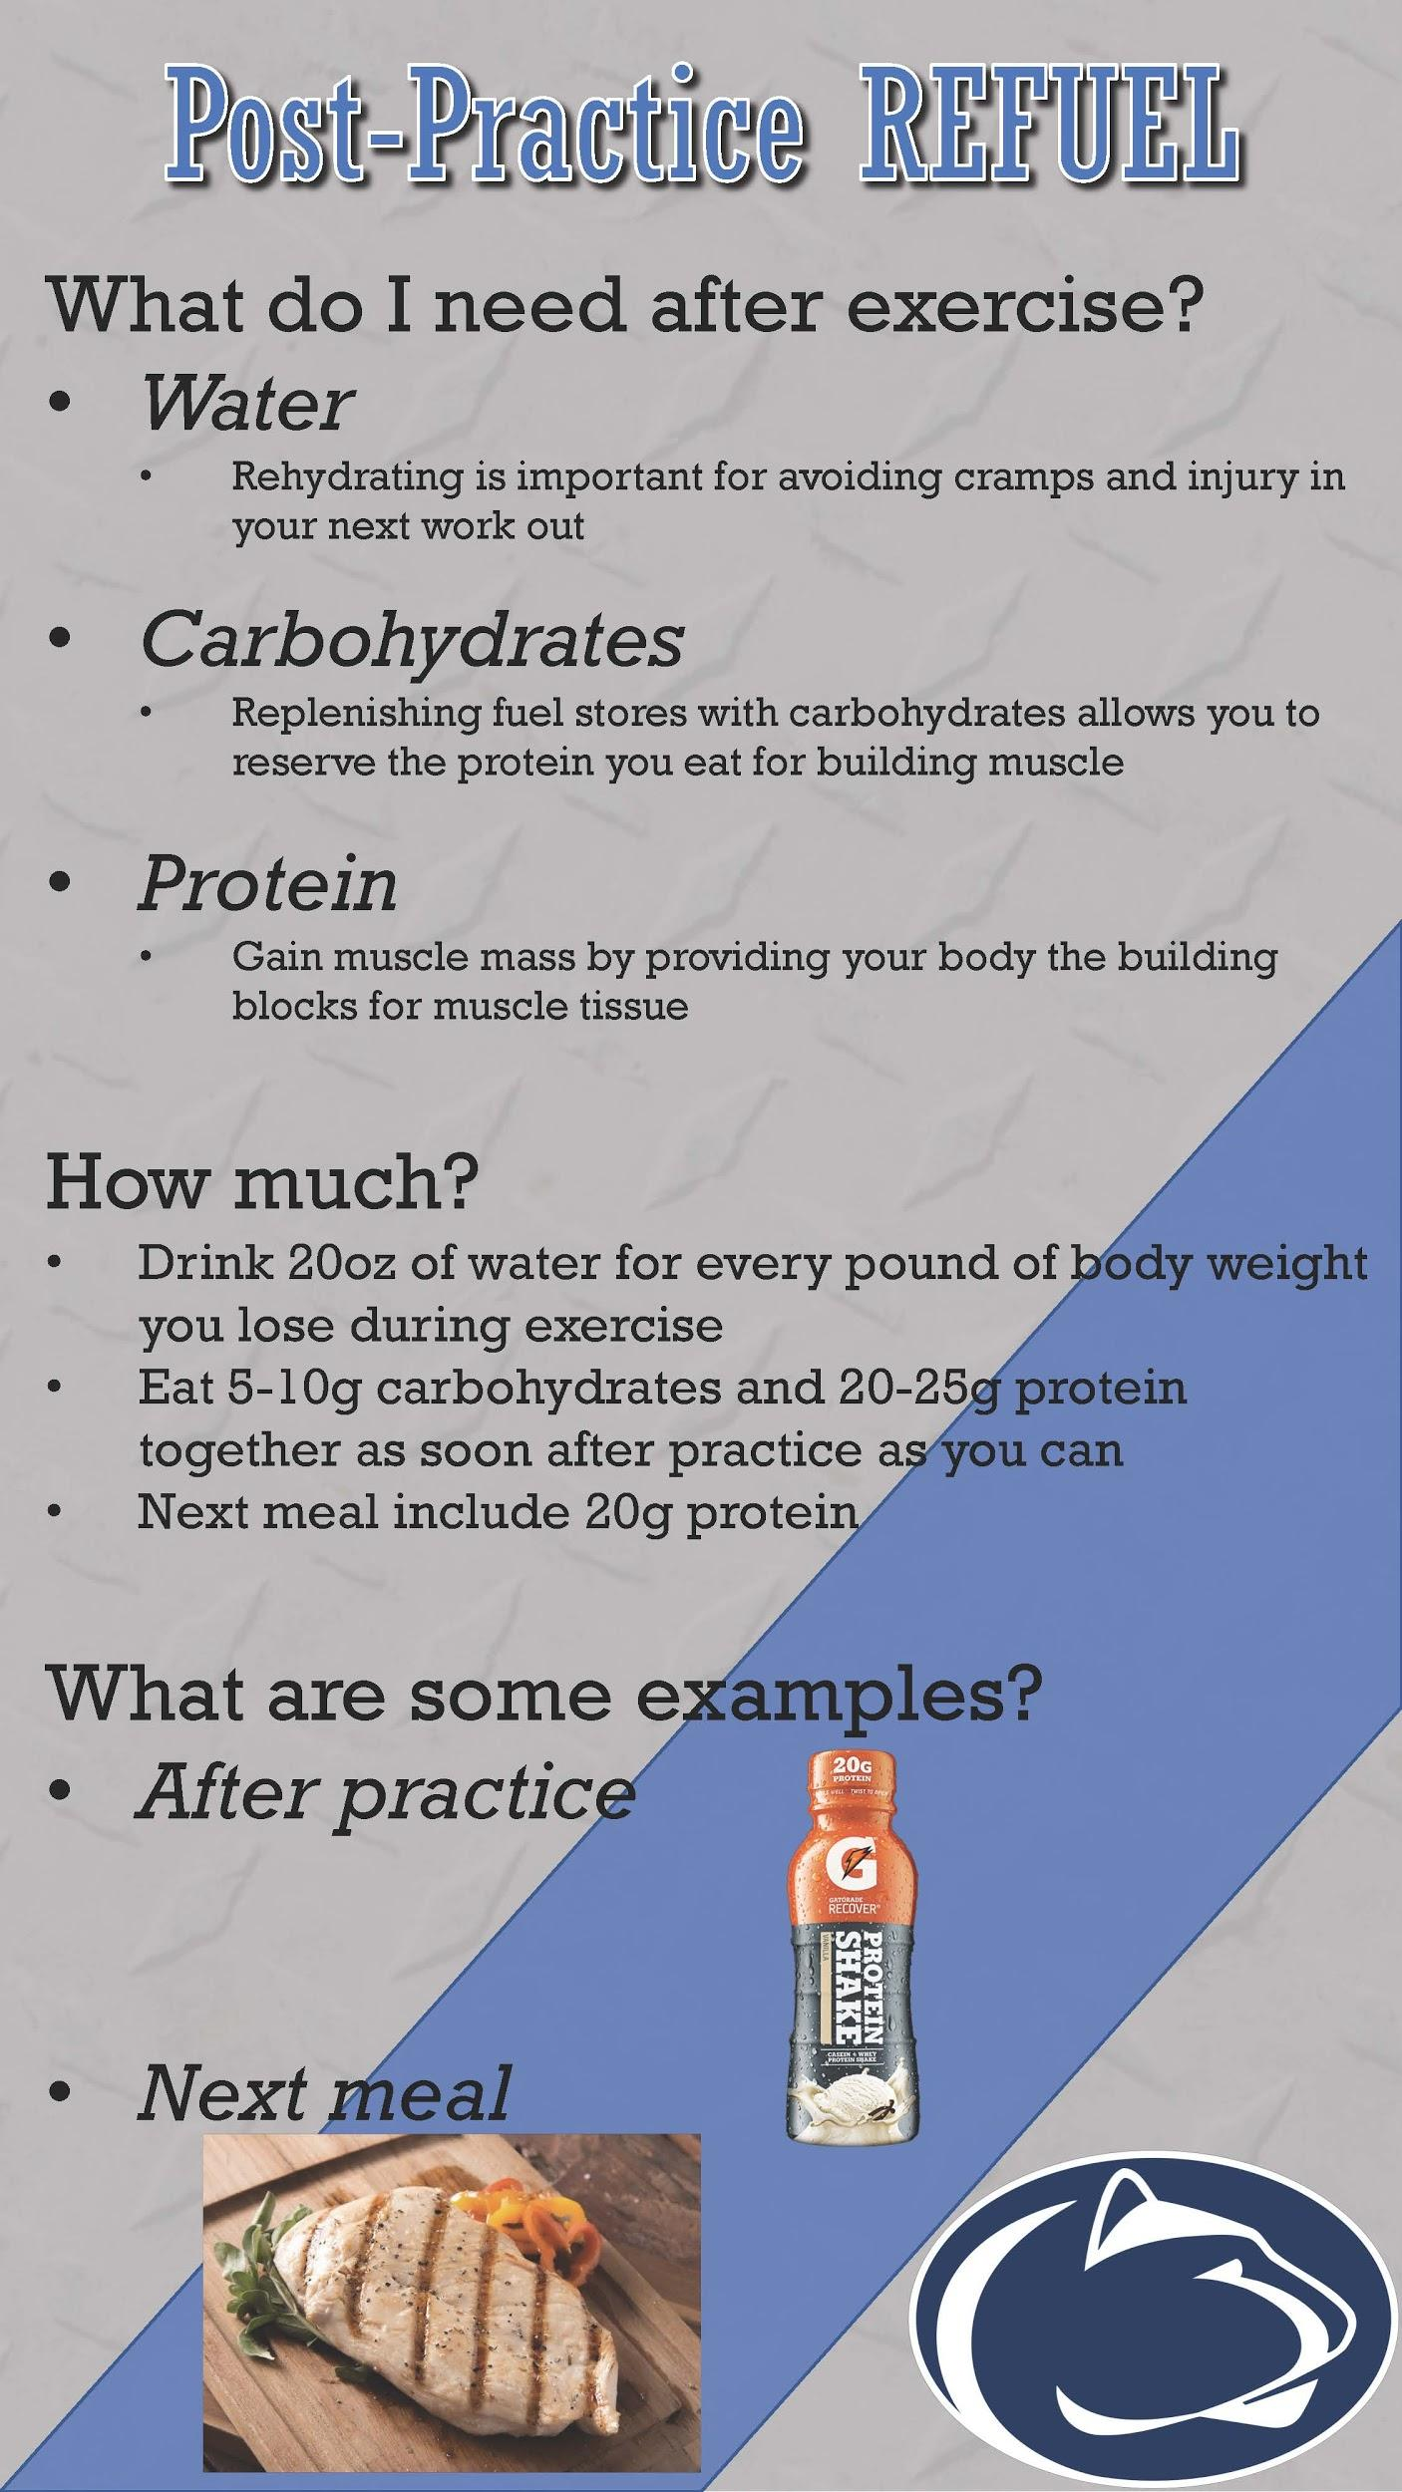

Slide 8
Team Talk
 | Male Athletes | Female Athletes
Sprint Swimmers | 35 mins: Dining Hall Tour (Fall) Describe what athletes’ meals should look like, they create a plate, compare afterwards, & eat 35 mins: Fuel Station Tour (Spring) Tour nat. fuel station after practice, describe pre- and post- workout/comp fuel | 35 mins: Dining Hall Tour (Fall) Describe what athletes’ meals should look like, they create a plate, compare afterwards, & eat 35 mins: Fuel Station Tour (Spring) Tour nat. fuel station after practice, describe pre- and post- workout/comp fuel
Distance Swimmers | 35 mins: Dining Hall Tour (Fall) Describe what athletes’ meals should look like, they create a plate, compare afterwards, & eat 35 mins: Fuel Station Tour (Spring) Tour nat. fuel station after practice, describe pre- and post- workout/comp fuel | 35 mins: Dining Hall Tour (Fall) Describe what athletes’ meals should look like, they create a plate, compare afterwards, & eat 35 mins: Fuel Station Tour (Spring) Tour nat. fuel station after practice, describe pre- and post- workout/comp fuel

Slide 9
Team Talk: Female Distance Swimmers- Fuel Station
After practice, meet at the Fuel Station in the Natatorium
Show what foods and snacks are available and describe when the best time to consume them is (provide handouts)
Pre- & post- workout fuel
Before, during, and after competitions
Describe where to find other Fuel Stations, what is offered, as well as other services for athletes
Discuss Female Athlete Triad
Should be discussed for both groups of females, as well as during Spring and Fall
Describe what it is and the importance of meeting caloric demands

Slide 10
References
Pre-Meet Carb Guide image sources:
https://newsnetwork.mayoclinic.org/discussion/the-power-of-blueberries/
https://www.walmart.com/ip/Rold-Gold-Tiny-Twists-Original-Pretzels-1-oz-88-count/51233615
https://taldepot.com/gatorade-prime-energy-chews-variety-pack-pack-of-374.html
https://www.amazon.com/Motts-Applesauce-pouches-count-Pack/dp/B00IHVRHRI
https://www.washingtonpost.com/recipes/whole-wheat-english-muffins/16565/?noredirect=on&utm_term=.8a74cfa677ce
Post-Practice Refuel image sources:
https://www.gatorade.com/products/protein-powders-and-shakes/protein-shake-vanilla-20g-protein-12-pack
https://assetcloud02.roccommerce.net/w750-h510-cpad//_rastelli/8/7/10/1569_antibioticfreechickenbreast_cooked.jpg
https://en.wikipedia.org/wiki/Penn_State_Nittany_Lions

